Slide 2
Lecture # 19
Course: Nanotechnology & Nanostructures
Instructor: Dr. Zohra Kayani
Notes:
to

Slide 3
Removal of Blood-Borne Toxin in the Body
Using Magnetic Nanospheres

Slide 4
List of Contents:
Nanospheres
Magnetic Nanospheres
Blood borne Toxic
Causes of BB toxic
Common Pathogen diseases
Transmission
How can I remove of Blood-Borne Toxin in the Body using Magnetic Nanospheres
The use of functionalized nanoparticles
Notes:
Nanospheres

Slide 5
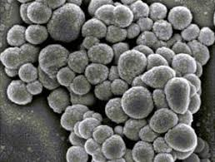
Nanospheres:
Nanospheres have small particle size; thus they are suitable to be administered orally, locally, and systemically.
Nanospheres are prepared using polymers that are biodegradable and biocompatible. They are used as delivery system in order to enhance entrapment and release of the drug.

Slide 6
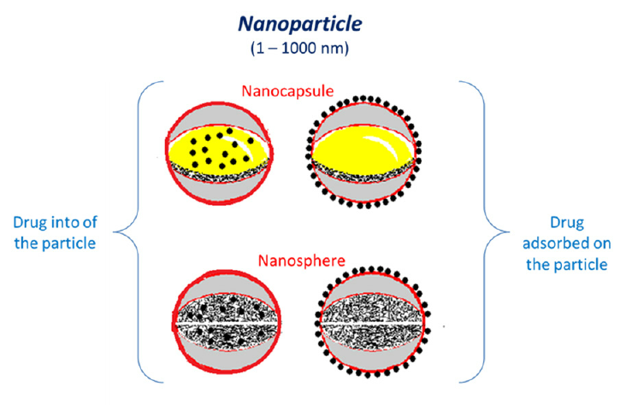
Nanospheres and nanocapsules are small vesicles used to transport drugs.diagram of nanosphere is given below.

Slide 7
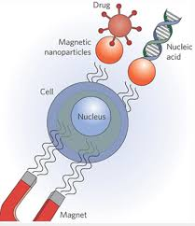
Magnetic Nanospheres:
Magnetic nanoparticles are a class of nanoparticle that can be manipulated using magnetic fields. Such particles commonly consist of two components, a magnetic material, often iron, nickel and cobalt, and a chemical component that has functionality.

Slide 8
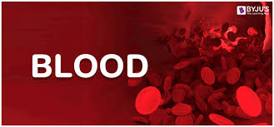
Blood-borne toxins:
Bloodborne pathogens are microorganisms such as viruses or bacteria that are carried in blood and can cause disease in people.

Slide 9
Causes of blood-borne toxins
Ingestion of biohazards can occur with the intake of contaminated food.
Toxins penetrate through the skin
Taken up by the lungs via inhalation of particulates

Slide 10
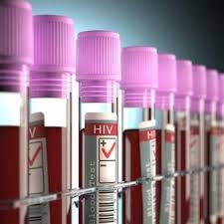
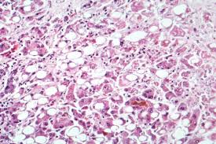
Common BB Pathogen Diseases
Malaria
Syphilis
brucellosis, and
Hepatitis B (HBV),
Hepatitis C (HCV)
Human Immunodeficiency Virus (HIV).
Notes:
Diseases caused by toxins

Slide 11
Transmission( How Diseases are spread)
Blood pathogens are spread by contact with blood or other potention inection material such as:
Salive
Semen
Notes:
Transmission( How Diseases are spread)
Blood pathogens are spread by contact with blood or other potention inection material such as:
Salive
Semen

Slide 12
How can I Remove of Blood-Borne Toxin in the Body Using Magnetic Nanospheres
The magnetic nanospheres are used for the treatment of BB pathogens.

Slide 13
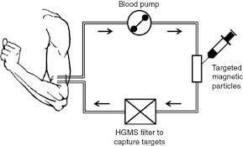
How drugs of magnetic particle inject into patient body?
The nanospheres are proposed for intravascular injection and circulation through the blood stream, thus capturing and selectively binding to the toxins via receptors on the particle surface.
Subsequent removal of the toxin-bound particles is achieved using a magnetic filter unit allowing purified blood to return to the body.

Slide 14
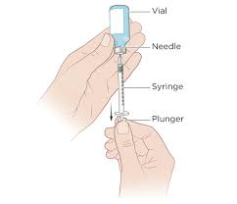
The magnetic nanospheres can be tailored with various receptors (conjugated to the surface of the particles) as applicable, to treat chemical, biological, or radiological agents.

Slide 15
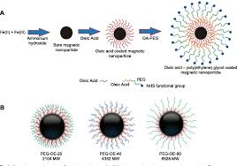
:
Use of functionalized nanoparticles:
The use of functionalized nanoparticles offers many potential, biomedical applications due to the versatility of applied receptors or encapsulation of drugs for targeted delivery.

Slide 16
The particles used
Must be of the proper size (100–2000 nm)
Be hidden to the immune system (PEG has been shown to be effective for vascular survival),
Possess magnetic components and receptors (allowing targeted delivery of drugs or recovery of toxins).

